Slide 1
A
B
C
D
E
F

Slide 2
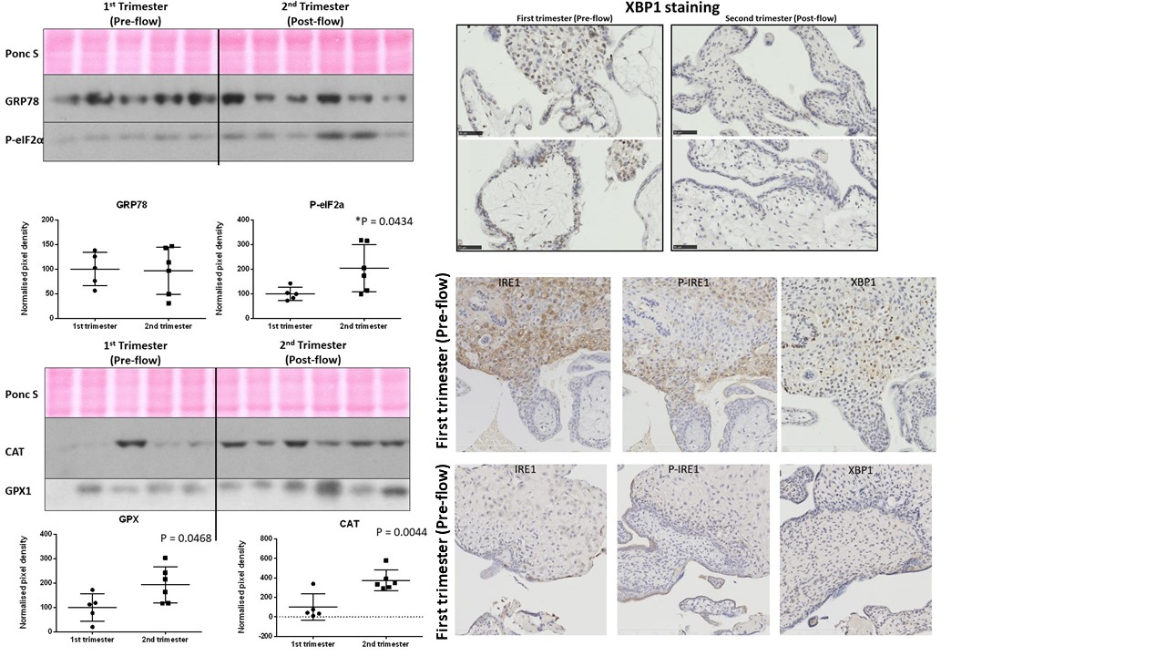
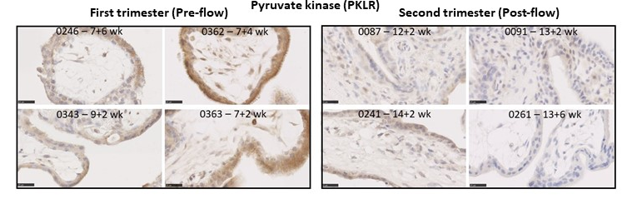
A
ER stress and processes
B
Secretory genes
C
Oxidative stress
D
E
F
G
H

Slide 3
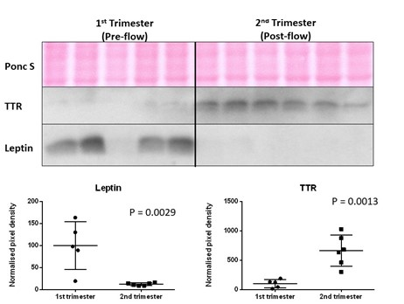
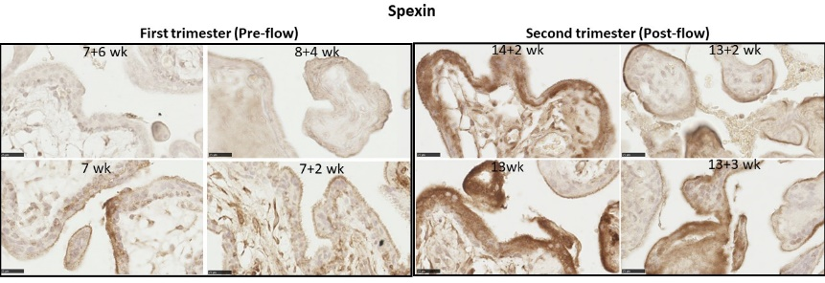
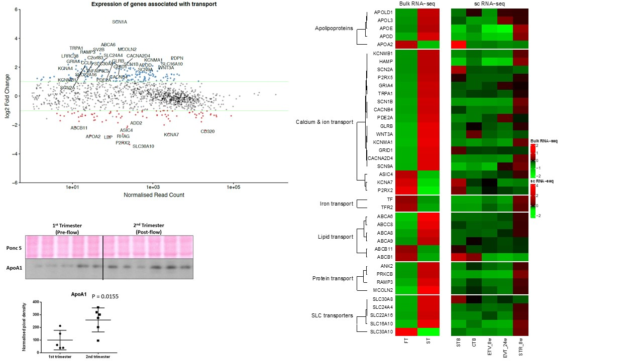
A
B
C
D
E
F

Slide 4
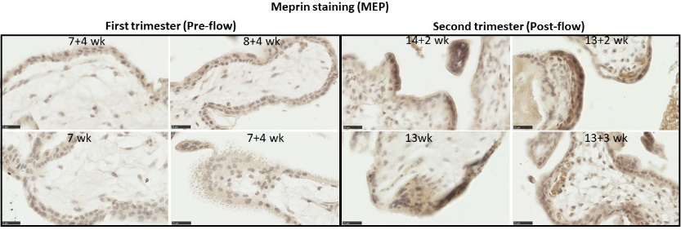
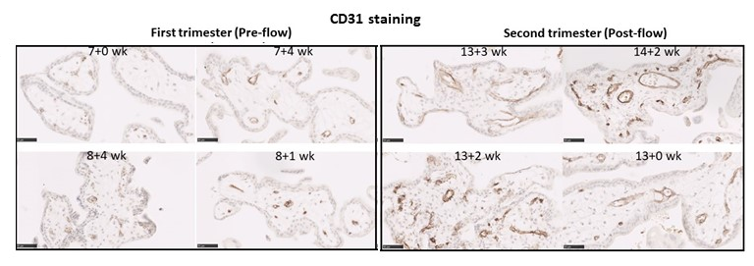
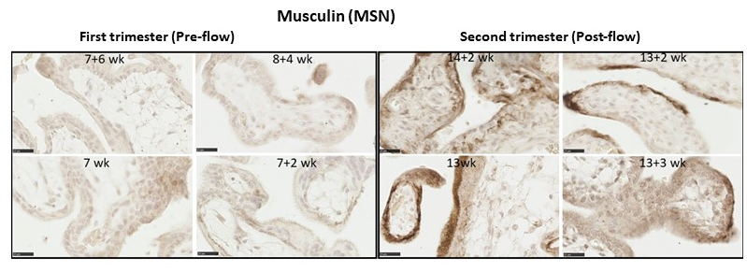
A
Transcription factors
B
WNT signaling
C
Cell cycle
D
E
F
G

Slide 5
A
C
B

